Slide 1
Time-optimal Flying a VTOL Drone
Leonardo Igler and Larissa Rickler

Slide 2
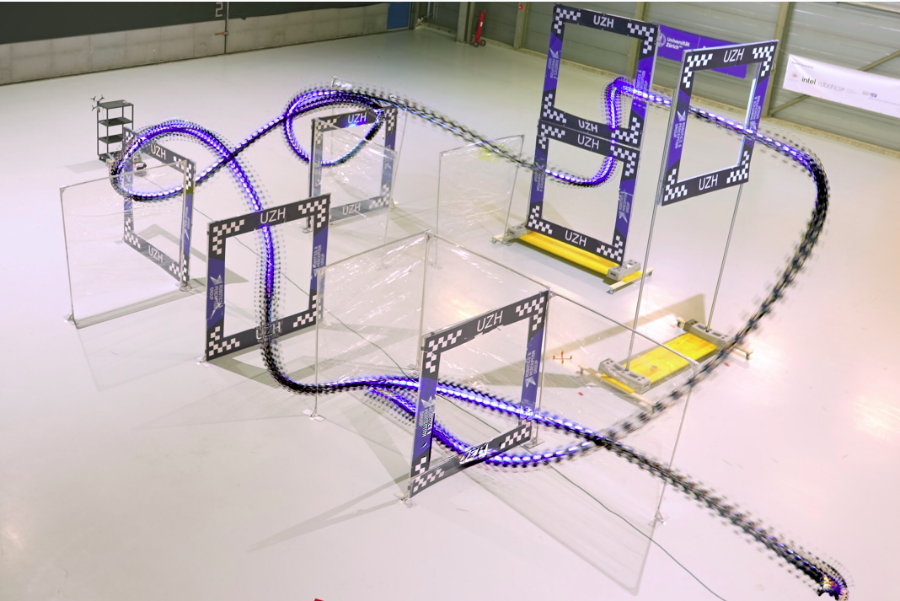
Topic and Motivation
Minimum-time flight for VTOL-Drone
Push platform to its limits
Use Cases:
Rescue
Delivery
Transportation
Fig. 1: Quadrotor races through a race track in the real world.

Slide 3
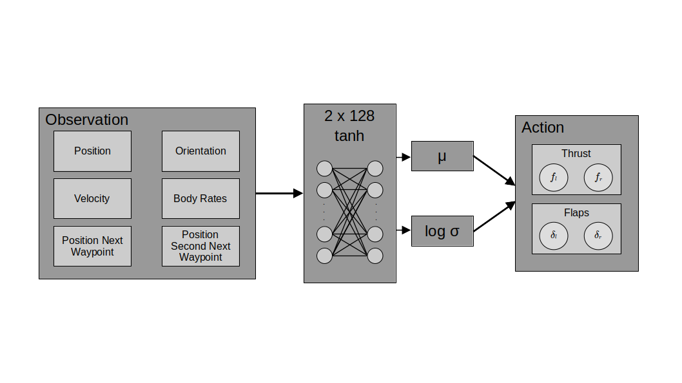
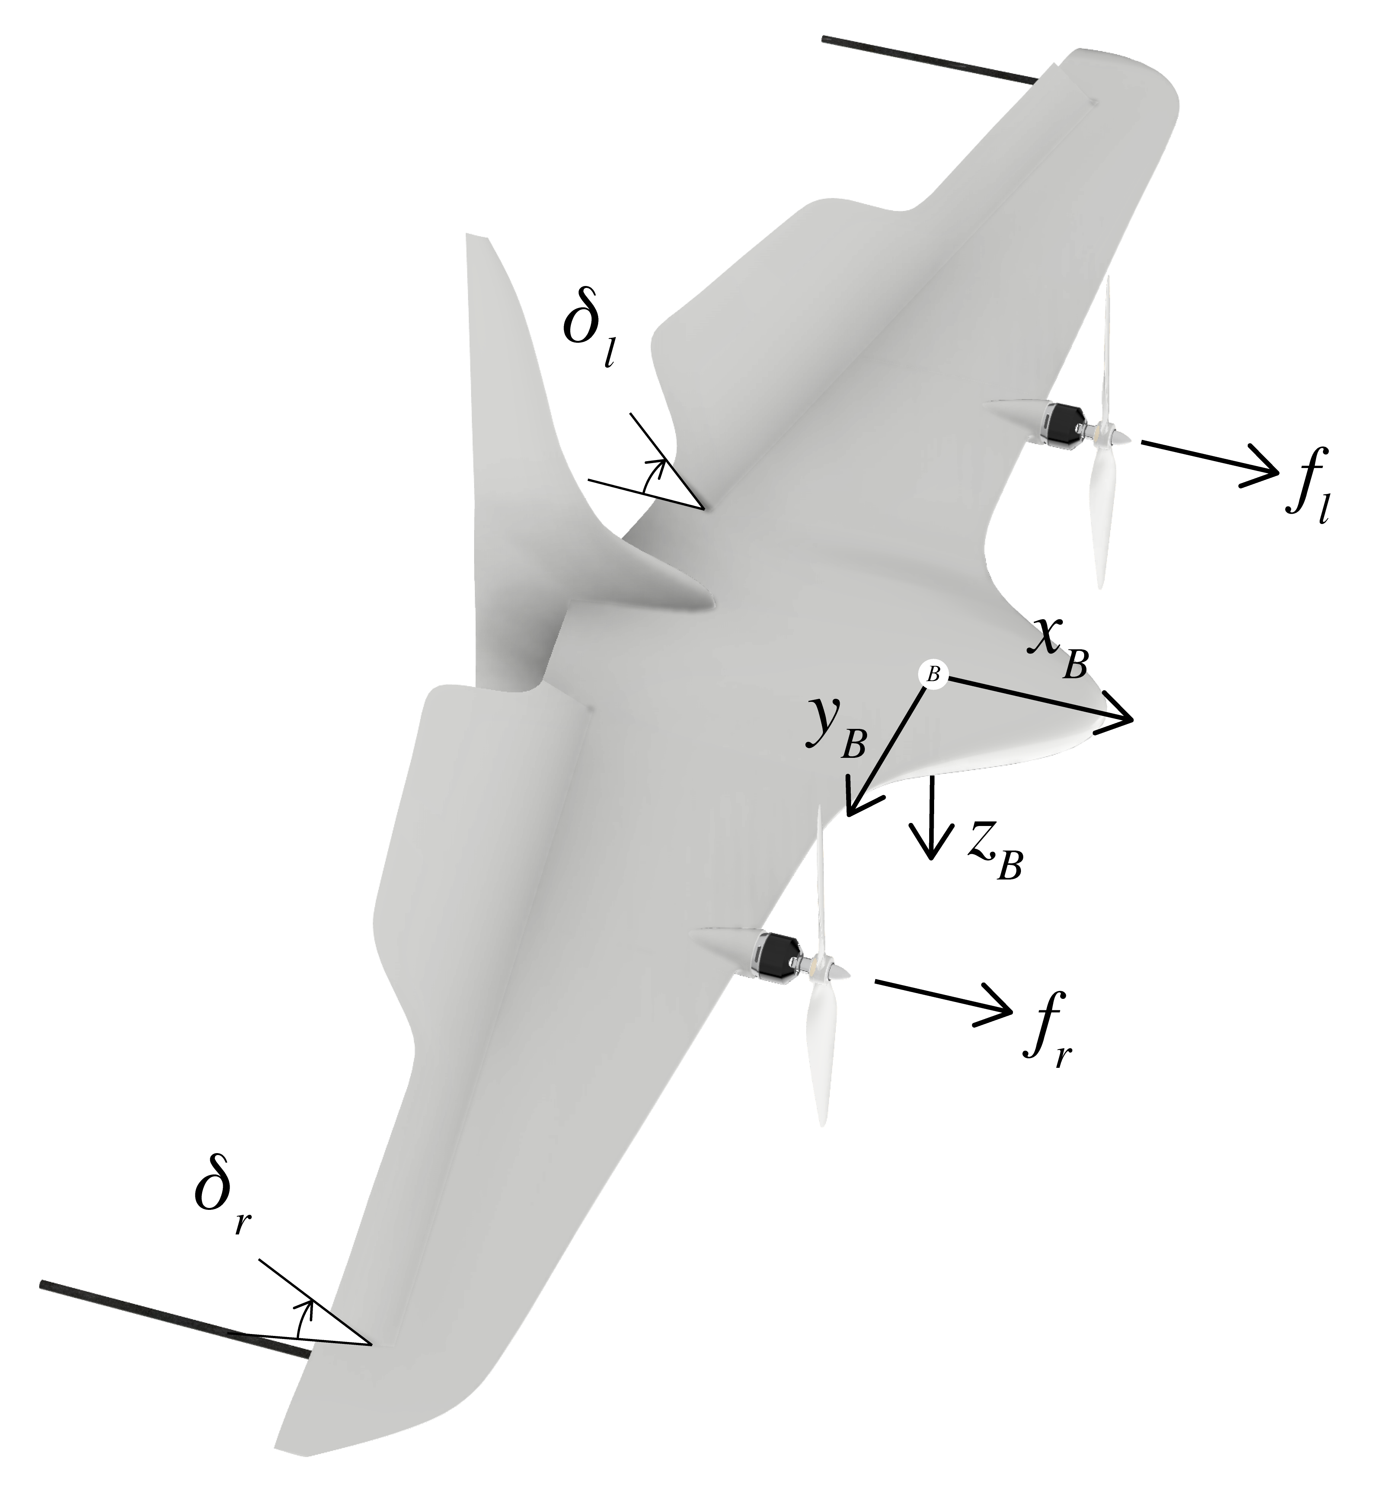
Our Approach
Actor Critic
Adam Optimizer

Slide 4
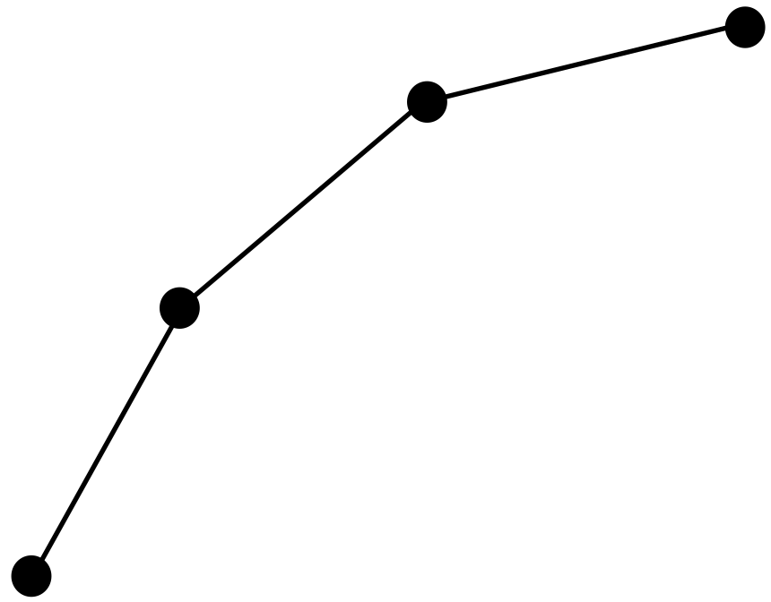
What has been done so far
Problem reduced to 2D
Steer towards single points
Fly along small random trajectories

Slide 5
Reward Function
Encourage line progression
Encourage reaching points
Penalize spinning
Penalize inactivity

Slide 6
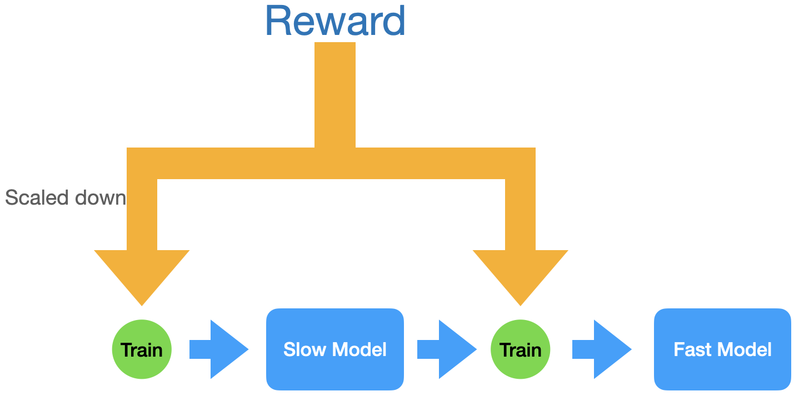
Training Strategy
Two Phases: Slow and Fast
Slow: Learn to follow path
Fast: Time optimality

Slide 7
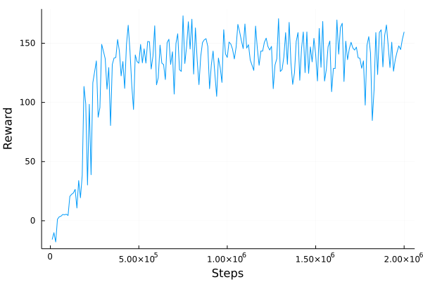
SLOW PLOTS

Slide 8
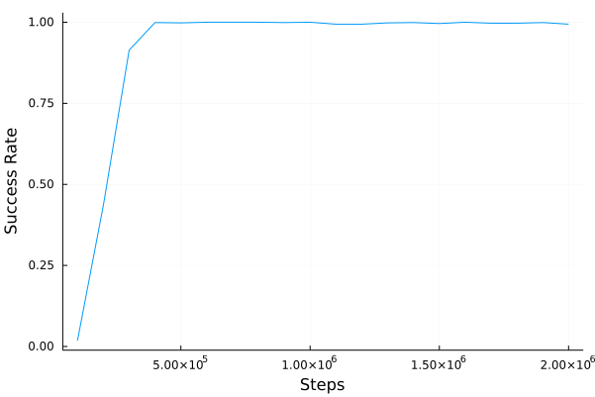
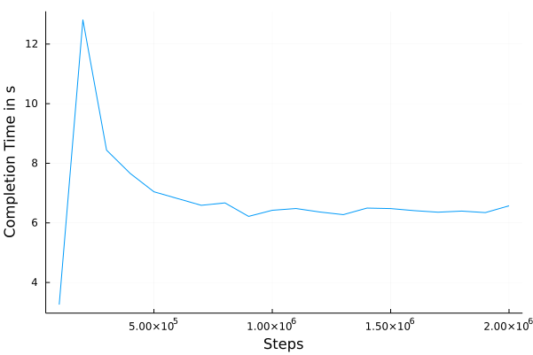
SLOW PLOTS

Slide 9
SLOW VIDEO
https://youtu.be/jzqBFTEnowo

Slide 10
FAST VIDEO
https://youtu.be/IRfzMXrSIUQ

Slide 11
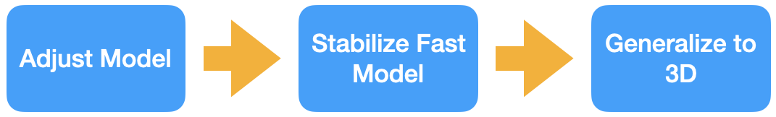
Next Steps

Slide 13
Image Sources
From https://arxiv.org/pdf/2203.15052v1.pdf
Fig. 1: Our quadrotor races through a complex race track inthe real world.

